Slide 1
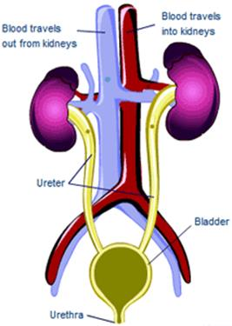
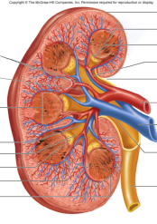
Introduction to
Renal Physiology
Professor Deepthi de Silva
Department of Physiology

Slide 2
At the end of this lecture you should be able to
State the main functions of the kidney
Outline the structure of the kidney and its functional unit, the nephron
Outline the blood flow to the kidney and the differences between the supply to cortical and juxtamedullary nephrons
Outline the role of the nephron in the formation of urine

Slide 3
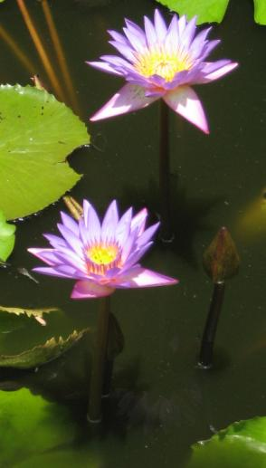
Why do you need to understand renal physiology?
Cells surrounded by fluid
  (much like the primordial organisms that started life)
Maintaining this environment is necessary for normal cellular function
The kidneys essential to maintain the internal environment

Slide 4
What do the kidneys do?
1. ‘Purify’ blood by removing waste products
  Creatinine, urea, uric acid, Hb breakdown products, hormones
  Drugs, food additives
2. Maintain the composition of blood (and ECF)
  Osmolarity
  Volume
  Acid base balance
  Ionic concentration
3. Hormone secretion
  Renin, erythropoietin, prostacyclins, Vitamin D
4. Blood pressure regulation – long term

Slide 5
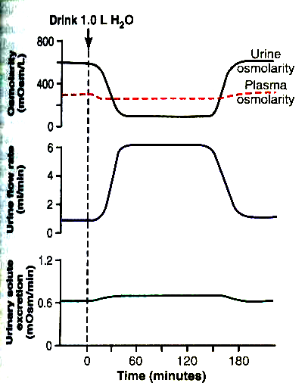
Homeostatic functions of the kidney
Drink 1.0L water
Water and electrolyte intake and output balanced
E.g Increased water intake causes ↑water excretion (without loss of solutes)
↑ intake of sodium -increased Na+ loss via the kidney.
Osmolality
mOsm/L
Urine flow rate mL/min
Urine solute loss mOsm/L

Slide 6
Structure of the kidneys
Surrounded by a capsule
  prevents overstretching
Renal blood and lymphatic vessels drain through the hilum; urine leaves the kidney to enter the ureters also at the hilum
Divided in to a cortex (outer) and medulla (inner)
  Medulla consists of pyramids
Pyramids drain via a papilla to the renal pelvis
The renal pelvis opens to the ureter

Slide 7
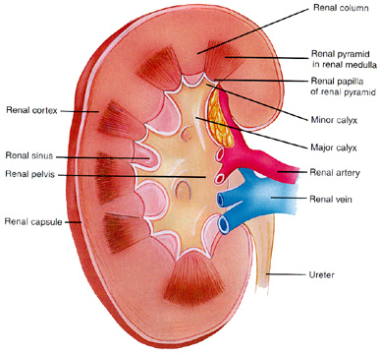
Structure of the kidneys
Renal pyramid in
renal medulla
Renal papilla
Renal Cortex
Minor Calyx
Major Calyx
Renal pelvis
Renal capsule
Ureter

Slide 8
The Nephron- functional unit of the kidney
Around 1 million in each kidney
Cortical nephrons
  Glomeruli in outer cortex and loop dips to medulla
Juxtamedullary nephrons (20-30%)
  Glomeruli in the inner cortex and loops plunge to the tips of the papillae
Decline in number of nephrons after 40y
  Renal function maintained as remaining nephrons increase their functional capacity

Slide 9
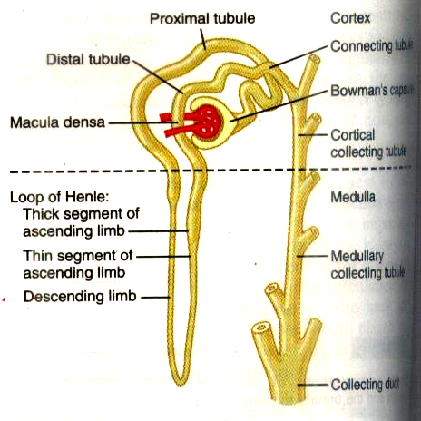

Slide 10
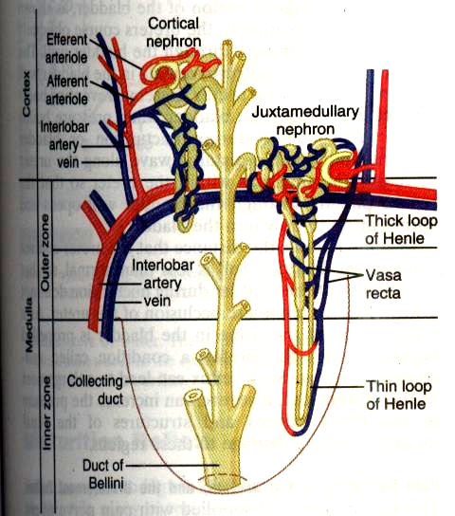

Slide 12
Renal Blood flow
Renal Artery
Interlobar arteries- radiate towards cortex
Arcuate arteries- At cortico- medullary junction
Interlobular arteries & afferent arterioles- Supply glomerulus
Efferent arterioles
Cortical Glomeruli
Peritubular Capillary network
Juxta medullary Glomeruli
Vasa recta OR peritubular capillaries
Drain to cortical venous system

Slide 13
Functional significance of renal blood supply
Glomerular capillaries at high pressure of around 45mmHg
  Promotes filtration of fluid to Bowman space
The peri-tubular capillary hydrostatic pressure is kept low and it has high [protein]
  enables reabsorption from the interstitial fluid

Slide 14
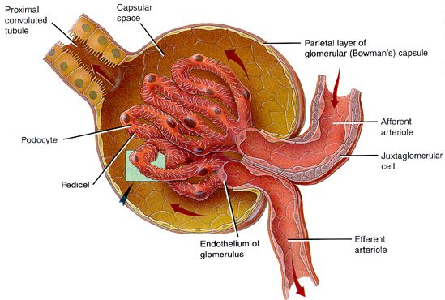
Functional aspects of the nephron
Glomerulus
    Bowman capsule and tuft of capillaries
    Ultra-filtration of plasma occurs here
    180L filtered a day
    Some substances removed from the plasma by filtration only

Slide 15
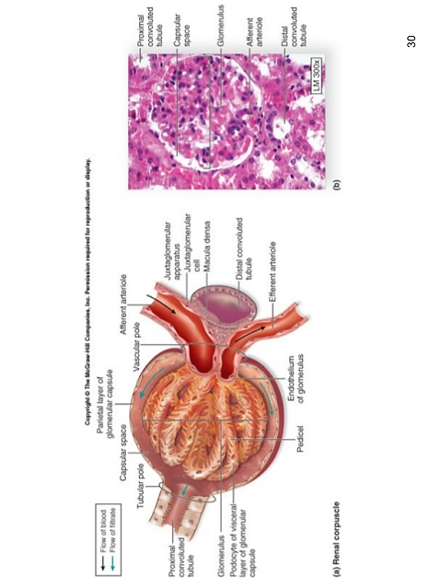
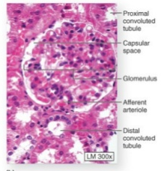
Juxtaglomerular Apparatus
Macula
densa
Lascis
cells
Macula densa –ascending limb LOH
Lascis cells
Afferent arteriole granular cells
Involved in tubulo-glomerular feedback
Renin- angiotensin Aldosterone secretion

Slide 16
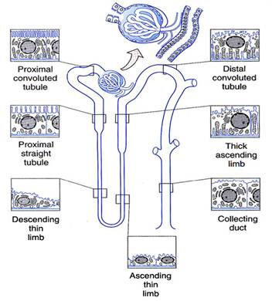

Slide 17
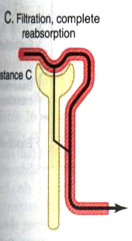
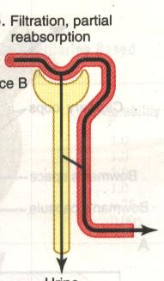
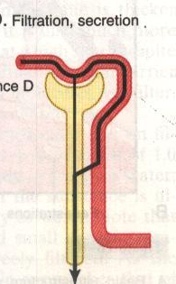
  Tubular System
  Proximal convoluted tubule
  Loop of Henle (descending & ascending limbs)
  Distal convoluted tubule
    Reabsorption of substances needed for the body
    Secretion of substances to maintain the body’s requirements
Reabsorption
Secretion

Slide 18
Review –
Types of membrane transport
Diffusion
    Simple diffusion
    Channel mediated diffusion
    Facilitated diffusion
Active transport
  Primary active transport
  Secondary active transport
Vesicular transport
Exocytosis
Endocytosis

Slide 19
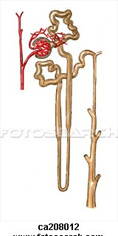
Collecting ducts drain to the ureter
Concentrate the urine
  Can be regulated by effects of antidiuretic hormone influence
  Water moves by osmosis

Slide 20
Renal Innervation
Nerves enter with blood vessels
  Sympathetic post ganglionic efferents (& few afferents)
  Vagal parasympathetic supply
Sympathetic supply to
  Afferent and efferent arterioles
  Proximal & distal tubules; thick ascending LOH
  Juxtaglomerular apparatus
Afferent nerves
  Nociceptors afferents mediate pain

Slide 21
What will you learn?
Blood flow via
afferent arterioles
Renal blood flow and
its regulation
Plasma filtered in to
Bowman capsule
Glomerular filtration &
its regulation
Tubular system
Reabsorption & secretion
Tubular functions-
mechanisms
Distal tubule & Collecting duct
Concentration of urine
Urine formation & its regulation
Urine expelled from the body
Micturition

Slide 22

Why does this occur?
What happens?
How is it regulated?

Slide 23
Clinical Correlations
Integration of renal functions with that of the endocrine system and cardiovascular system
  To maintain the composition of the extracellular fluid
What happens when the kidney does not work?
  Physiological basis of the treatment of renal failure
Physiological basis for other urinary diseases

Slide 24
What you need to revise
Body fluid compartments and volumes
Electrolyte distribution & normal values for plasma Na⁺, K⁺, HCO3⁻, Glucose
Transport of substances across the cell membrane
Oedema
Osmolarity and osmolality

Slide 25
Types of membrane transport
Diffusion
    Simple diffusion
    Channel mediated diffusion
    Facilitated diffusion
Active transport
  Primary active transport
  Secondary active transport
Vesicular transport
Exocytosis
Endocytosis

Slide 26
Reference Books
Ganong
Guyton
Crash Course

